Slide 1
CMU SSD1:
Introduction to Information Systems
Yang Liu
School of Software
Central South University
yangliu@mail.csu.edu.cn
Yang Liu

Slide 2
Unit 1 The World Wide Web
1.2 What's in the Web?
  1.2.1 What's in a Web Page?
  1.2.2 A First Look at HTML
  1.2.3 A More Detailed Look at HTML
  1.2.4 Creating Links to Other Documents
  1.2.5 Images and Multimedia
  1.2.6 Organizing the Process, Validation, and DOCTYPE Elements
  1.2.7 Some Final Thoughts
Yang Liu

Slide 3
1.2 What's in the Web?
What's in a Web Page?
A First Look at HTML
A More Detailed Look at HTML
Create Links
Images
Organizing the Process, Validation, and DOCTYPE Elements
Some Final Thoughts
Yang Liu

Slide 4
What's in a Web Page?
中南大学 http://www.csu.edu.cn/
信息系统基础SSD1秋季 https://www.educoder.net/classrooms/15953/shixun_homework
中南大学图书馆 https://lib.csu.edu.cn/
淘宝 https://www.taobao.com/
哔哩哔哩 https://www.bilibili.com/
VSCode编辑器 https://code.visualstudio.com/
网络之广,无处不在；网页之多,无奇不有。
Yang Liu

Slide 5
What's in a Web Page?
View Source
The type of file you are looking at when you view a page's source is a text file.
The difference between text file and word file.
A Web page is "written" in HTML language.
tags
Browser
Yang Liu

Slide 6
Experimentation is Important
It is a good idea to get in the habit of looking at the Web page source when you browse.
You should always do a little experimenting when you are working on exercises.
Experimentation is one of the major ways we learn how to write Web pages or Java programs
You should find experimental practice is one of the more enjoyable aspects of programming.
Yang Liu

Slide 7
A First Look at HTML
HTML－ Hypertext Markup Language
  Language is a term we all understand.
  Markup is the process of preparing manuscripts for typesetting by marking them with directions about font type and size, indentation, spacing, and the like.
  Text refers to the words on the computer screen that we are marking up.
  Hypertext would create links between related topics in different papers, stands for the notion of creating linked, nonlinear structures of information endured.
Yang Liu

Slide 8
A More Detailed Look at HTML
The remarkable fact about HTML is that it has already become a widely accepted standard, and browsers that can display HTML documents have become commonplace and available for most types of computers.
Yang Liu

Slide 9
Choice of Editor
The editor must allow to save documents as text files.
The editor must also allow to save documents with .html extensions or .htm extensions.
  ex. index.html or MyFirstWebPage.htm
By saving files in text format, you force the word processor to leave out its own special formatting characters, which Web browsers cannot read.
About the extension file name.
Yang Liu

Slide 10
HTML Structure
HEAD
TITLE
HTML
BODY
background
a
href name
h1,h2,h3...
img
src
p
br
ul
ol
strong
li
li
em
Yang Liu

Slide 11
HTML Structure
<HTML> </HTML>
  An HTML document should begin and end with this tag pair.
<HEAD> </HEAD>
  This tag pair should follow immediately after the <HTML> tag to denote the document header.
<TITLE> </TITLE>
  This tag pair should be between the <HEAD> </HEAD> pair.
<BODY> </BODY>
  All of a Web page's content will come between the beginning and ending BODY tags.
Yang Liu

Slide 12
HTML Structure
Ex.
  <HTML>
  <HEAD>
  <TITLE>
  Title of My First Web Page
  </TITLE>
  </HEAD>
  </HTML>
Yang Liu

Slide 13
HTML Structure
Ex.
  <HTML>
  <HEAD>
  <TITLE>
    My First HTML Page
  </TITLE>
  </HEAD>
  <BODY>
    WELCOME TO MY FIRST WEBPAGE
  </BODY>
  </HTML>
Yang Liu

Slide 14
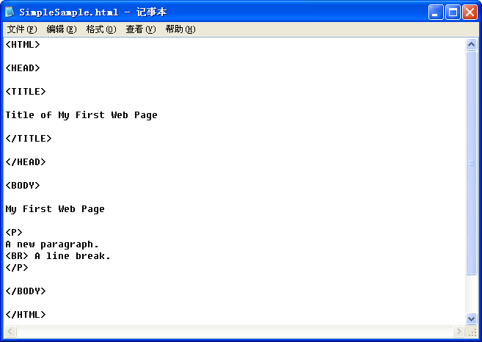
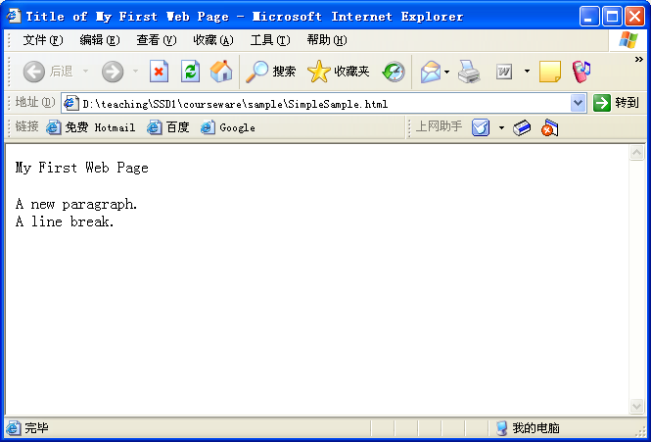
Yang Liu

Slide 15
tags
tags
  The symbols that we add to the text to tell Web browsers how to display that text are called tags .
  Each tag is enclosed inside a pair of angle brackets ( "<" and ">" ).
  Most tags come in beginning and ending pairs that follow the syntax <TAGNAME> and </TAGNAME>
<tagname>
text enclosed by two tags
</tagname>
Yang Liu

Slide 16
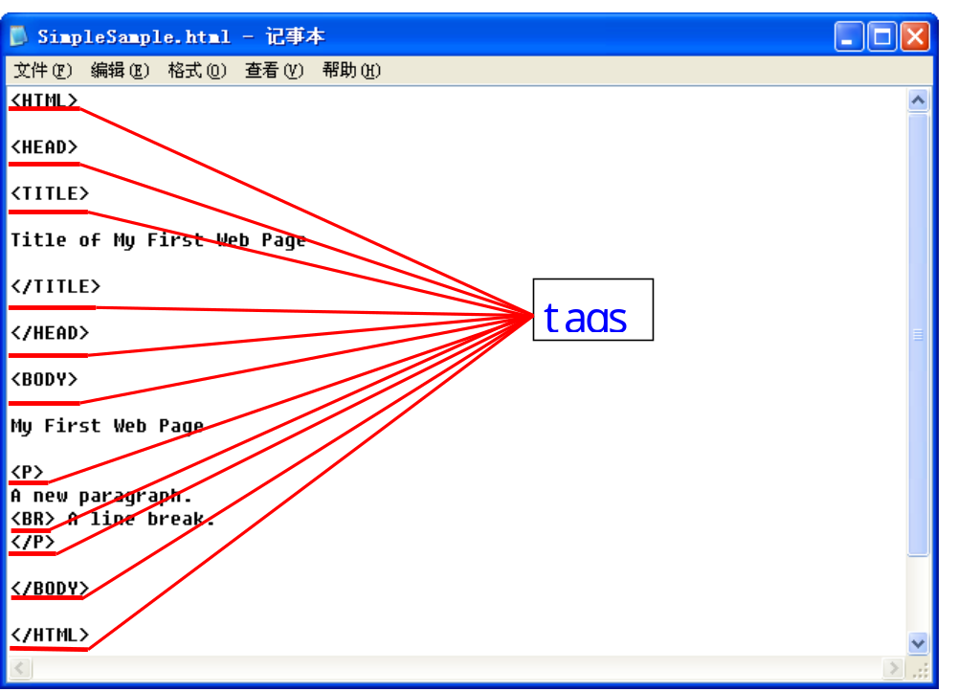
Yang Liu

Slide 17
<P> <BR>
<P> </P>
  <P> marks the beginning of a new paragraph, and the </P> tag marks the end of the paragraph.
<BR>
  To tell a browser to display a line break .
You can use either an uppercase or a lowercase P, but our convention is uppercase.
Yang Liu

Slide 18
Examples
<P>This is the first sentence of the paragraph and the browser will add line breaks wherever needed to fit it on the page.<BR>This will be a new line in the display.<BR>So will this one.</P>
<P>
This is the first sentence of the paragraph and the browser will add line breaks wherever needed to fit it on the page.
<BR>
This will be a new line in the display.
<BR>
So will this one.
</P>
Yang Liu

Slide 19
Notes
The browser will ignore all of the extra white space we've added to make the text easier to read and will simply display the text according to the instructions provided by the HTML tags in the text.
Yang Liu

Slide 20
Comment
Comment (注释)
  "<!--" and "-->"
  A remark to be put in among the page content but DO NOT want these to be displayed by a browser.
  Ex. <!-- This is a comment. -->
Yang Liu

Slide 21
Font styles
Physical style tags
  Tell browsers to use certain font styles.
tag | effect
<B> </B> | Bold
<I> </I> | Italics
<TT> </TT> | Monospace(fixed width)
<U> </U> | Underline
<SUB> </SUB> | Subscript_{Subscript}
<SUP> </SUP> | Superscript ^{Superscript}
Yang Liu

Slide 22
Font styles
Logical style tags
  Allow browsers to decide how to display the text .
tag | effect
<EM> </EM> | Emphasized text
<STRONG> </STRONG> | Strongly emphasized text
<CITE> </CITE> | Text in citation
<SAMP> </SAMP> | Text in a computer screen output sample
Yang Liu

Slide 23
Size and Color
Example1.html
Size and Color tags
  <BODY BGCOLOR=RED> or <BODY BGCOLOR="#FF0000">
  <FONT SIZE=7>
  <FONT COLOR=RED>
Yang Liu

Slide 24
Color
Black = "#000000" Green = "#008000"
Silver = "#C0C0C0" Lime = "#00FF00"
Gray = "#808080" Olive = "#808000“
 Yellow = "#FFFF00"
Maroon = "#800000" Navy = "#000080"
Red = "#FF0000" Blue = "#0000FF"
Purple = "#800080" Teal = "#008080"
Fuchsia = "#FF00FF" Aqua = "#00FFFF"
White = "#FFFFFF"
Yang Liu

Slide 25
Headings/HR
Headings
  <H1> and </H1> delimits highest-level headings
  <H6> and </H6> delimits lowest-level headings
Horizontal Lines
  <HR> creates a horizontal line on a Web page.
  attributes for <HR>: SIZE, WIDTH, ALIGN, NOSHADE
  Ex. <HR SIZE=10 WIDTH=75 ALIGN=CENTER>
Yang Liu

Slide 26
PRE
Preformatted Text
  You can make browsers use the formatting you designate by using the PRE tag (where pre stands for preformatted) .
  <PRE> </PRE>
Example2.html
Yang Liu

Slide 27
&lt; &gt; &nbsp;
Special Characters
  &lt; - less than <
  &gt; - greater than >
  &nbsp; - non-blocking space
Yang Liu

Slide 28
LISTS
Lists
  <OL> for ordered (or numbered) lists
  <UL> for unordered lists
  <LI> creates items
Type of <OL>: 1,a,A,i,I
Type of <UL>: disc, circle, square
Example3.html
Yang Liu

Slide 29
Create Tables
<TR></TR> stands for table row.
<TH></TH> stands for table header.
<TD></TD> stands for table data.
<TABLE>
<CAPTION> text of caption goes here </CAPTION>
<TR> <TH> column 1 name </TH><TH>column 2 name </TH> </TR>
<TR> <TD> row1,col1 data </TD><TD>row1,col2 data </TD></TR>
</TABLE>
Yang Liu

Slide 30
Create Links
URL
  Protocol identifier: http://
  Host name: www.icarnegie.com
  Resource name: /courses.html
    Ex. http://www.icarnegie.com/courses.html
Yang Liu

Slide 31
Absolute Links
Links
  Absolute Links
    A complete URL.
    http://www.csu.edu.cn/chinese/outline/index.htm
Yang Liu

Slide 32
Relative Links
  Relative Links
    Relative URLs are URLs that, at the upper end of the range, lack only a protocol identifier and a host name. At the lower end of the range, relative URLs can consist of only a resource file name.
    /afs/cs/user/jar/www/index.html
    index.html
Yang Liu

Slide 33
Href
Links tag
  <A href> </A>
  <A href='http://www.sina.com/news.html'>
  Sina: In the News</A>
  <A href='FA.html'> Freshman Advisor</A>
Link To Other File
Yang Liu

Slide 34
Href
Links tag
  <A href> </A>
  <A name='office'><H2>Jim's Office</H2></A>
  <A href='Jim.html#office'>Jim’s Office</A>
Link To a Place Other on the Same Web Page
Yang Liu

Slide 35
Notes
URL Absolute Path, URL Relative Path (Relative to root, Relative to resource)可以适用于网页中的哪些标签？
适用任何的网页元素，图片、超级链接、flash、音频、视频、frame网页等。
Yang Liu

Slide 36
Notes
Experiment about links
  DemoRelToResURL.html
  DemoRelToRootURL.html
  Using Complete and Relative URLs in a Web Page
  Creating a Link to Other Files
  Creating an Internal Link to a Place on the Same Web Page
  Embedding an Image into Your Web Page
Once you've mastered the use of individual tags, try combining them
Yang Liu

Slide 37
Images
.jpg
  used for JPEG (Joint Photographic Experts Group) files.
  compressed.
  support more colors, but some of the original image information is lost during compression.
.gif
  used for GIF (Graphics Interchange Format) files.
  compressed.
  limited in the range of colors while none of the original image information is lost .
Yang Liu

Slide 38
Images
Image tag － <IMG>
  <IMG src=‘.jpg’ alt=‘图片说明’>
Picture.html
Yang Liu

Slide 39
CSS
CSS (Cascading Style Sheets) 用于渲染HTML元素标签的样式
  内联样式：
  在HTML元素中使用"style" 属性
  内部样式表：
  在HTML文档头部 <head> 区域使用<style> 元素来包含CSS
  外部引用：
  使用外部 CSS 文件

Slide 40
CSS的内联样式
当特殊的样式需要应用到个别元素时，可以使用内联样式。
使用内联样式的方法是在相关的标签中使用样式属性。
<p style="color:blue;margin-left:20px;">
This is a paragraph.
</p>
<p style=“font-family:arial;color:red;font-size:20px;”>
This is another paragraph.
</p>
<body style="background-color:yellow;">
<h2 style="background-color:red;">这是一个标题</h2>
<p style="background-color:green;">这是一个段落。</p>
</body>

Slide 41
CSS的内部样式表
当单个文件需要特别样式时，就可以使用内部样式表。
可以在<head> 部分通过 <style>标签定义内部样式表。
<head>
<style type="text/css">
body {background-color: yellow;}
p {color: blue;}
</style>
</head>

Slide 42
CSS的外部样式表
当样式需要被应用到很多页面的时候，外部样式表将是理想的选择。
使用外部样式表，可以通过更改一个文件来改变整个站点的外观。
<head>
<link rel="stylesheet" type="text/css" href="mystyle.css">
</head>

Slide 43

CSS规则的基本语法
CSS 规则由两个主要的部分构成：选择器，以及一条或多条声明。
选择器 {property: value}
  选择器通常是您需要改变样式的 HTML 元素
  每条声明由一个属性和一个值组成
  属性（property）是希望设置的样式属性（style attribute）
  每个属性有一个值，属性和值用冒号分开
h1 {color:red; font-size:14px;}

Slide 44
CSS规则的基本语法
p{
text-align:center;
color:black;
font-family:arial;
}
body{
color:#000;
background:#fff;
margin:0;
padding:0;
font-family:Georgia,Palatino,serif;
}

Slide 45
HTML4中不建议用的标签和属性
在HTML 4,原来支持定义HTML元素样式的标签和属性已被弃用,这些标签将不支持新版本的HTML标签。
  不建议使用的标签有: <font>, <center>, <strike>
  不建议使用的属性: color 和 bgcolor.

Slide 46
Organizing the Process
Define the Web page content.
Plan the look of the page and the links needed.
Implement the Web page by writing it incrementally in small steps.
Evaluate the Web page in two ways:
  test to see that it's HTML is correct
  check to see that its appearance satisfies you and, as you have opportunity, other people.
Yang Liu

Slide 47
Verification and Validation
HTML validator
  A validator is a tool that checks source code for not only the gross errors that even the most forgiving browsers catch but also of violations of various published conventions.
  HTML validators help us determine if HTML code conforms to a particular published specification: HTML 4.01, HTML 4.0, or HTML 3.2
WDG (Web Design Group) HTML Validator
CSE HTML Validator
Yang Liu

Slide 48
Verification and Validation
WDG HTML Validator
http://htmlhelp.com/tools/validator
CSE HTML Validator
http://www.htmlvalidator.com
Yang Liu

Slide 49
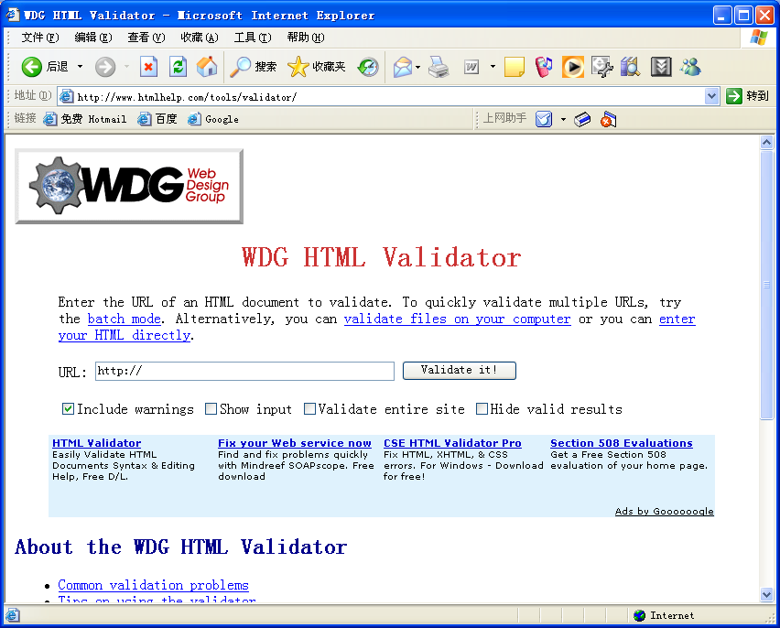
Yang Liu

Slide 50
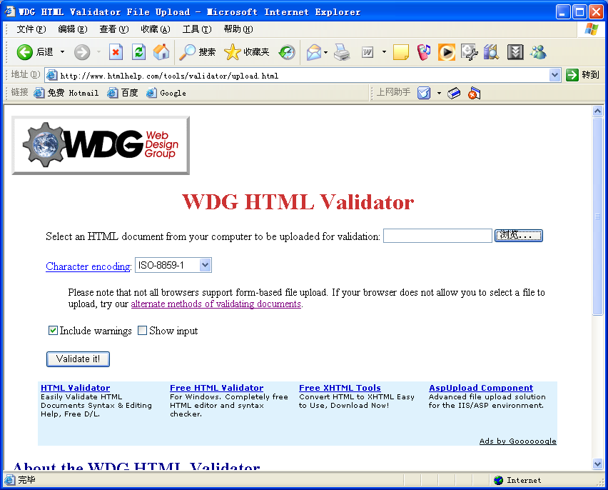
Yang Liu

Slide 51
The DOCTYPE Element
DOCTYPE element's purpose is to tell agents that process Web files—such as validators, Web browsers, and the like—what HTML specification is followed in the file's source.
DOCTYPE elements are supposed to be on the very first line of a file, right before the beginning <HTML> tag.
<!DOCTYPE HTML PUBLIC '-//W3C//DTD HTML 4.0 Transitional//EN'>
Yang Liu

Slide 52
Some Final Thoughts
Remember that JPEG and GIF files take time to download.
look at the Web page source when you browse.
What kind of information do you find in the source files.
Find some sites introducing information about HTML.
Yang Liu

Slide 53
Practicing
You really must do a lot of practicing in addition to doing the exercises.
Practicing one hour a day, seven days a week is much better than practicing for three on Saturday and four on Sunday.
Yang Liu

Slide 54
Thank you ！
Yang Liu

